Slide 1
Testing of Hypotheses
Session 15
17/04/2021

Slide 2
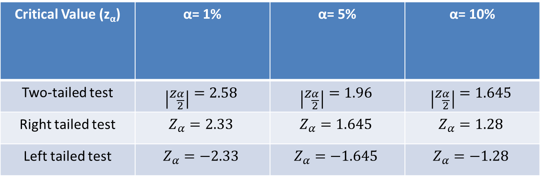
Critical values of Z at commonly used level of significance
Critical Value (z_{α}) | α= 1% | α= 5% | α= 10%
Two-tailed test | $$\left|z_{\frac{α}{2}}\right|=2.58$$ | $$\left|z_{\frac{α}{2}}\right|=1.96$$ | $$\left|z_{\frac{α}{2}}\right|=1.645$$
Right tailed test | $$Z_{α}=2.33$$ | $$Z_{α}=1.645$$ | $$Z_{α}=1.28$$
Left tailed test | $$Z_{α}=−2.33$$ | $$Z_{α}=−1.645$$ | $$Z_{α}=−1.28$$

Slide 3
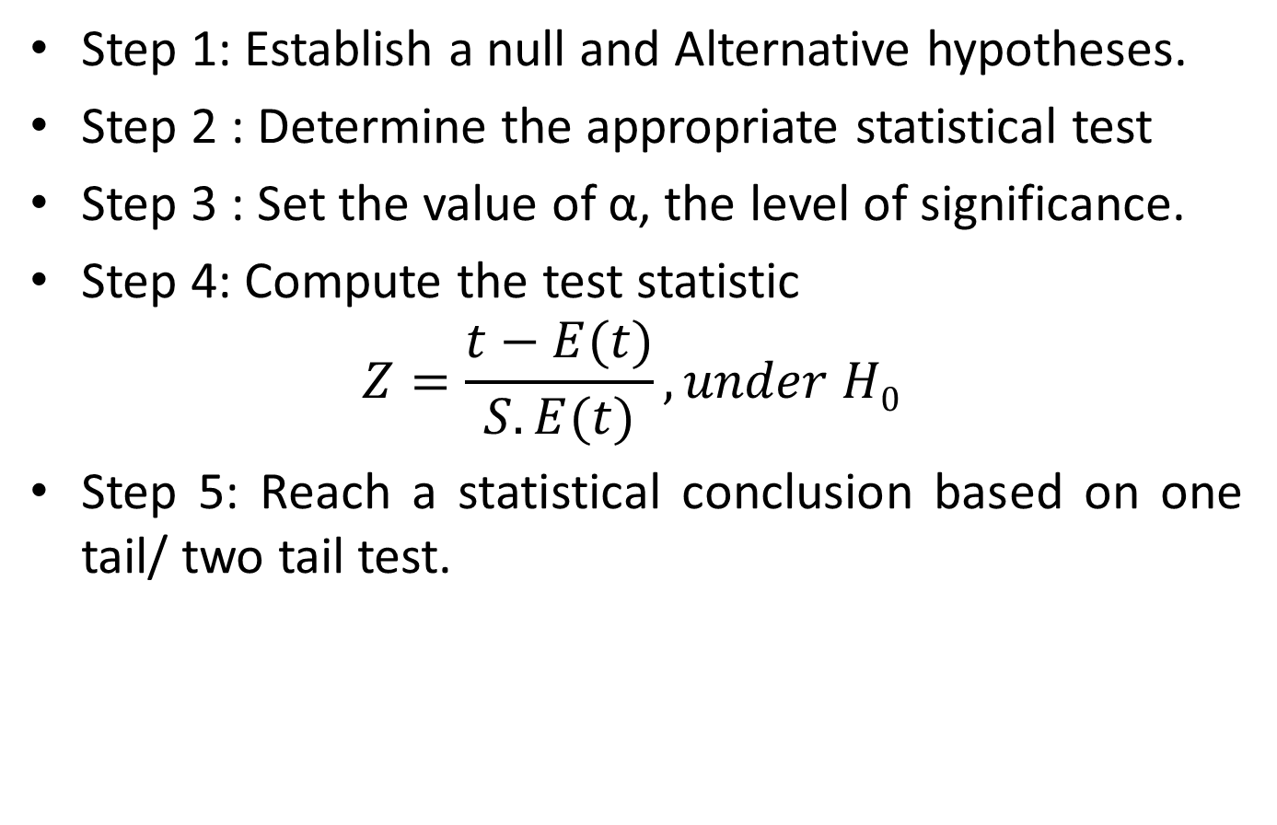
Procedure for testing of Hypothesis(critical value approach)
Step 1: Establish a null and Alternative hypotheses.
Step 2 : Determine the appropriate statistical test
Step 3 : Set the value of α, the level of significance.
Step 4: Compute the test statistic
$$Z=\frac{t−E(t)}{S.E(t)}, under H0$$
Step 5: Reach a statistical conclusion based on one tail/ two tail test.

Slide 4
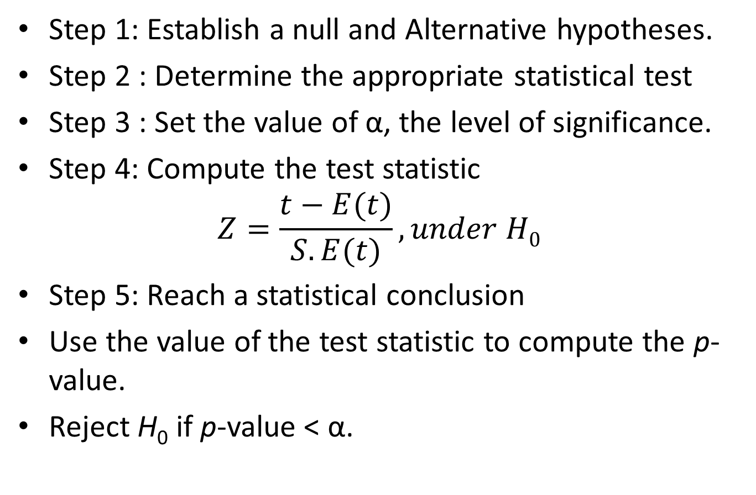
Procedure for testing of Hypothesis (p-value approach)
Step 1: Establish a null and Alternative hypotheses.
Step 2 : Determine the appropriate statistical test
Step 3 : Set the value of α, the level of significance.
Step 4: Compute the test statistic
$$Z=\frac{t−E(t)}{S.E(t)}, under H0$$
Step 5: Reach a statistical conclusion
Use the value of the test statistic to compute the p-value.
Reject H₀ if p-value < α.

Slide 5
Confidence Interval Value approach
A point estimate is a statistic taken from a sample that is used to estimate a population parameter. A point estimate is only as good as the representativeness of its sample.
If other random samples are taken from the population the point estimates derived from those samples are likely to vary.
Because of this variation in the sample statistic, estimating the population parameter with an interval estimate is often preferable.
An interval estimate (Confidence Interval) is a range of values within which an analyst can declare with some confidence, the population parameter lies.

Slide 6
Testing Hypotheses about a population mean using the z statistic (σ known)
One of the most basic hypotheses tests is a test about a population mean.
A business researcher might be interested to determine whether an established or accepted mean value for an industry is still true or in testing a hypothesized mean value for a new theory or product
A retail store wants to test to determine whether the average age of its customers is less than 40 years.
A manufacturing company wants to test to determine whether the average thickness of a plastic bottle is 2.4 millimeters.

Slide 7
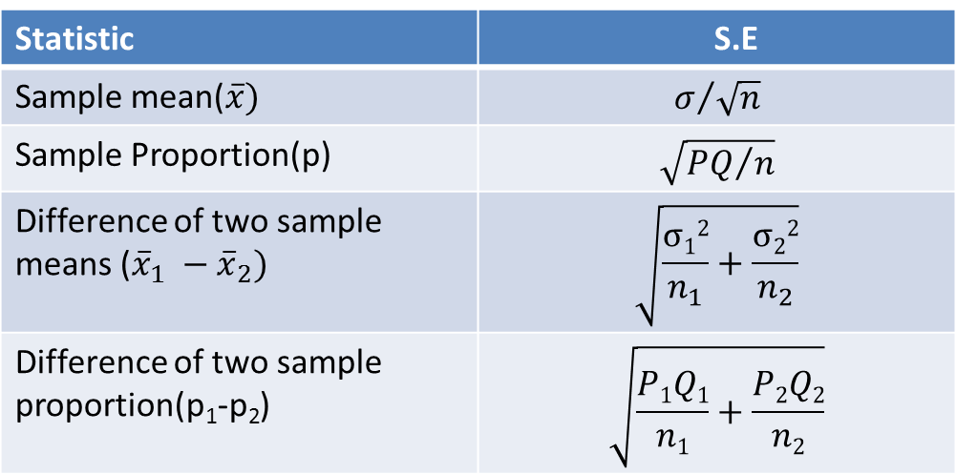
Standard error of sample mean/proportion
Standard Error: The standard deviation of the sampling distribution of a statistic is known as its Standard Error (S.E). The S.E of some of well known statistic are given below (for large samples).
Statistic | S.E
Sample mean($\overline{x})$ | $$σ/{\sqrt{n}}$$
Sample Proportion(p) | $$\sqrt{{PQ}/n}$$
Difference of two sample means (${\overline{x}}_{1} −{\overline{x}}_{2})$ | $$\sqrt{\frac{σ12}{n_{1}}+\frac{σ22}{n_{2}}}$$
Difference of two sample proportion(p₁-p₂) | $$\sqrt{\frac{P1Q1}{n1}+\frac{P2Q2}{n2}}$$

Slide 8
Test-1(a):Test for population mean μ : One sample z test (σ known )
 | Left tail test | Right tail test | Two tailed test
Hypotheses
Test statistic
Rejection rule | Reject if | Reject if | Reject if
Where is the critical value obtained from the standard
normal distribution

Slide 9

Testing the mean with a finite population
If the hypothesis test for population mean is being conducted with a known finite population, the population information can be incorporated into the hypothesis testing formula.
In this case, a statistical adjustment can be made to the z formula. This adjustment is called finite correction factor:
$$\sqrt{\frac{N−n}{N−1}}$$

Slide 10


Test-1(b):Test for population mean μ : One sample z test (σ known and N finite)
 | Left tail test | Right tail test | Two tailed test
Hypotheses
Test statistic
Rejection rule | Reject if | Reject if | Reject if
$$z= \frac{\overline{x}−μ_{0}}{\frac{σ}{\sqrt{n}}\sqrt{\frac{N−n}{N−1}}}$$
$$z= \frac{\overline{x}−μ_{0}}{\frac{σ}{\sqrt{n}}\sqrt{\frac{N−n}{N−1}}}$$
$$z= \frac{\overline{x}−μ_{0}}{\frac{σ}{\sqrt{n}}\sqrt{\frac{N−n}{N−1}}}$$
Where is the critical value obtained from the standard
normal distribution

Slide 11

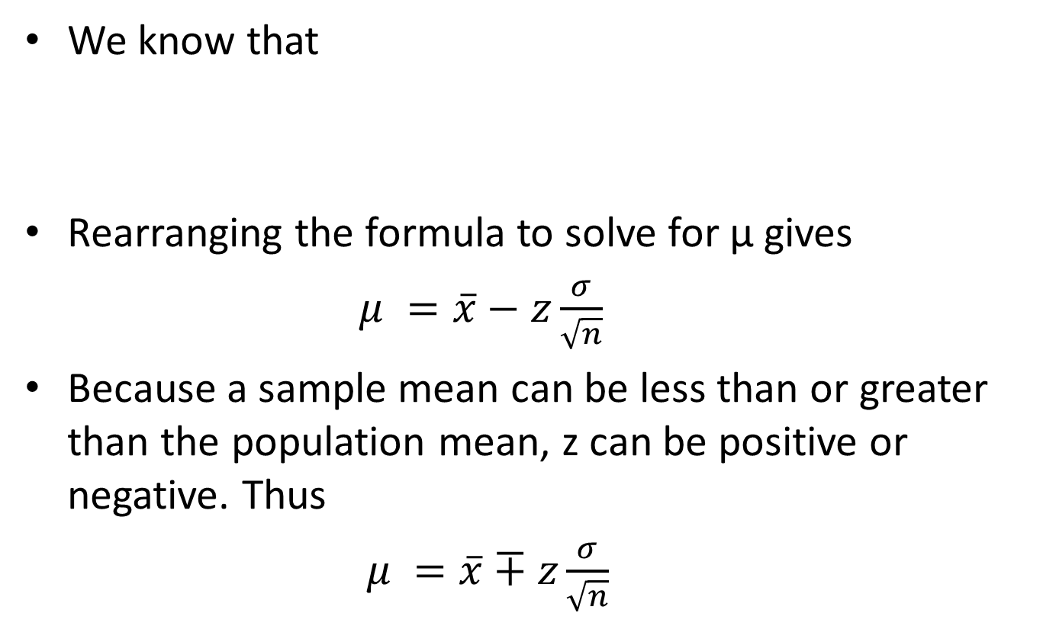
Confidence interval for Population mean (σ known)
We know that
Rearranging the formula to solve for μ gives
$μ =\overline{x}−z\frac{σ}{\sqrt{n}}$
Because a sample mean can be less than or greater than the population mean, z can be positive or negative. Thus
$μ =\overline{x}∓z\frac{σ}{\sqrt{n}}$
$$z=\frac{\overline{x}−μ}{\frac{σ}{\sqrt{n}}}$$

Slide 12
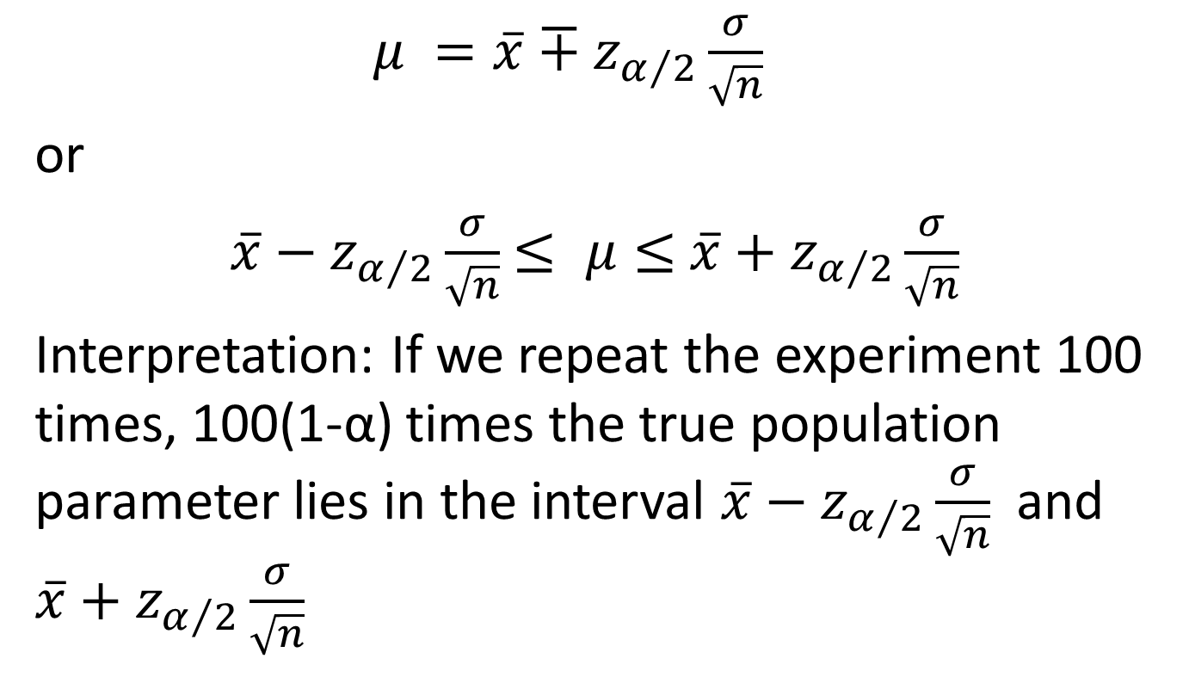
100(1-α)% confidence interval to estimate μ (σ known)
$μ =\overline{x}∓z_{α/2}\frac{σ}{\sqrt{n}}$
or
$\overline{x}−z_{α/2}\frac{σ}{\sqrt{n}}$ $≤ μ≤$ $\overline{x}+z_{α/2}\frac{σ}{\sqrt{n}}$
Interpretation: If we repeat the experiment 100 times, 100(1-α) times the true population parameter lies in the interval $\overline{x}−z_{α/2}\frac{σ}{\sqrt{n}}$ and $\overline{x}+z_{α/2}\frac{σ}{\sqrt{n}}$

Slide 13
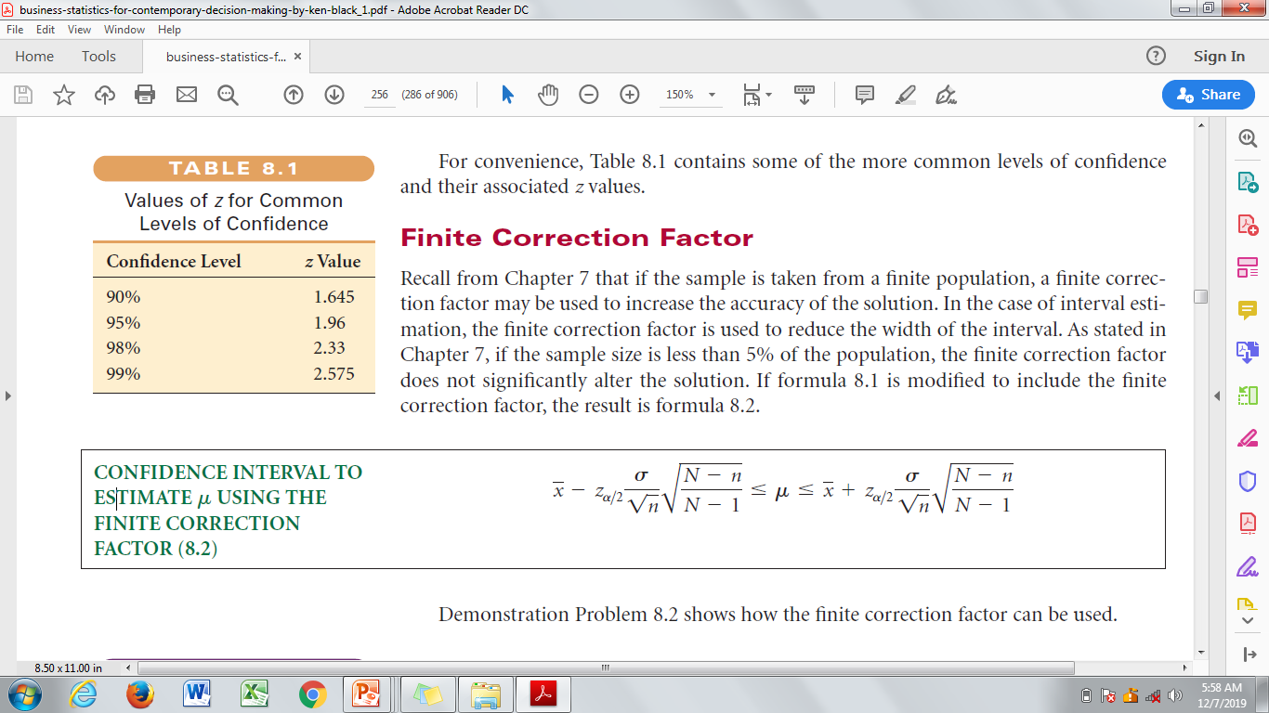
100(1-α)% confidence interval to estimate μ (σ and N are known)

Slide 14
Numerical Problems based on single mean
(1) According to U.S Bureau of Labor Statistics, the average weekly earnings of a production worker in 1997 were $424.2. Suppose labor researcher wants to test to determine whether this figure is still accurate today. The researcher randomly selects 60 production workers from across the U.S. and obtain a representative earnings for one week from each. The resulting sample average is $435.7. Assuming a population standard deviation of $33 and a 5% level of significance, determine whether mean weekly earnings of a production worker has changed?

Slide 15

Solution : Given $μ_{0= }$
$H_{0}$: $H_{1}:$
Test Statistic
α=0.05
Rejection Rule

Slide 16
(2) A survey in U.S. found that the average net income for sole proprietor CPAs is $74,914. Because this survey is done more than 15 years ago, an accounting researcher wants to test this figure by taking a random sample of 112 sole proprietor accountants in the U.S. and found that the average net income is $78695. The researcher is interested to determine whether net income figure has increased. Assume population standard deviation (s.d) of net incomes for sole proprietor CPAs is $14,530

Slide 17

Solution : Given $μ_{0=}$
$H_{0}$: $H_{1}:$
Test Statistic
α=0.05
Rejection Rule :

